Slide 1

Regret Minimization Algorithms for Kuhn Poker
Yousef Radwan

Slide 2
Overview
Regret minimization is a key tool for solving imperfect-information games (like poker).
Algorithms like CFR and CFR+ have been used to solve very large poker variants.
We compare four regret-based algorithms on Kuhn Poker:
CFR, CFR+, NormalHedge, NormalHedge+ (our hybrid).
Goal: understand convergence behavior and the impact of regret truncation (RM+) across variants of Kuhn Poker.

Slide 3
Why Regret Minimization in Kuhn Poker?
Imperfect-information games (poker, security games, auctions) require robust strategies; Nash equilibrium is the gold standard.
Regret minimization gives algorithms that converge to equilibrium in repeated play.
Full poker games are huge → we use Kuhn Poker:
Tiny game, but still has hidden information, bluffing, and non-trivial equilibrium.
Kuhn Poker is our testbed to:
Compare different regret algorithms in a controlled environment.
Prototype new variants like NormalHedge+ before scaling up.

Slide 4
Related Work: CFR Family
CFR – Counterfactual Regret Minimization
Introduced for large imperfect-information games (e.g., poker).
Uses counterfactual regret at each information set; average strategy converges to Nash equilibrium.
CFR+ (CFR Plus)
Improvement over CFR using regret truncation (RM+):
Regret is updated as R[a] = max(R[a] + δ, 0).
Speeds up convergence in practice, especially in poker benchmarks.
CFR/CFR+ have been used in major poker AIs (e.g., solving heads-up limit Texas Hold’em in prior works).

Slide 5
Related Work: NormalHedge
NormalHedge is a parameter-free online learning / experts algorithm.
Key ideas:
We maintain weights over actions proportional to an exponential potential of their regret.
No learning rate tuning; automatically focuses on better-performing actions.
Compared to CFR-style linear regret matching:
CFR: Action probabilities ∝ positive regret (linear).
NormalHedge: Action probabilities ∝ exp(potential(regret)) (nonlinear / exponential).
NormalHedge is usually studied in the experts setting; here it’s adapted to game tree regret minimization.

Slide 6
Background: Kuhn Poker
Deck: 3 cards – Jack (J), Queen (Q), King (K).
Players: 2; each antes 1 chip and is dealt one private card.
Basic actions:
CHECK/BET for player 0; then CHECK/CALL/FOLD depending on history.
Example outcomes:
cc: both check → showdown, win/lose ±ante.
bf: P0 bets, P1 folds → P0 wins +ante.
bc: bet–call → showdown for ±(ante + bet).
cbf: check–bet–fold → P0 loses ante.
cbc: check–bet–call → showdown for ±(ante + bet).
The Nash value (e.g., -1/18 in standard configuration) is known analytically → perfect for measuring algorithm error.

Slide 7
Regret & Regret Matching
Regret for an action = “How much better I would have done if I had always chosen this action instead.”
Simple example:
Over multiple rounds, compare actual payoff vs. payoff if you had always taken action B.
Sum “missed gains” → regret for B.
Positive regret:
If regret > 0 → you wish you had played this action more.
If regret ≤ 0 → this action didn’t help; ignore it.
Regret Matching rule:
Probability of action a ∝ max(regret[a], 0).
If all regrets ≤ 0 → pick uniformly at random.

Slide 8
Counterfactual Regret & Information Sets
Information set = what a player can see:
Their card + observed action history, but not opponent’s card.
"Jc" (Jack + check history).
Counterfactual value:
“Utility I would get from this info set, assuming I reach it with probability 1 and others play according to the current strategies.”
Counterfactual regret:
Regret computed using these counterfactual values.
Allows local updates at each information set, independent of actual path probability.
This is what enables CFR to scale to large game trees.

Slide 9
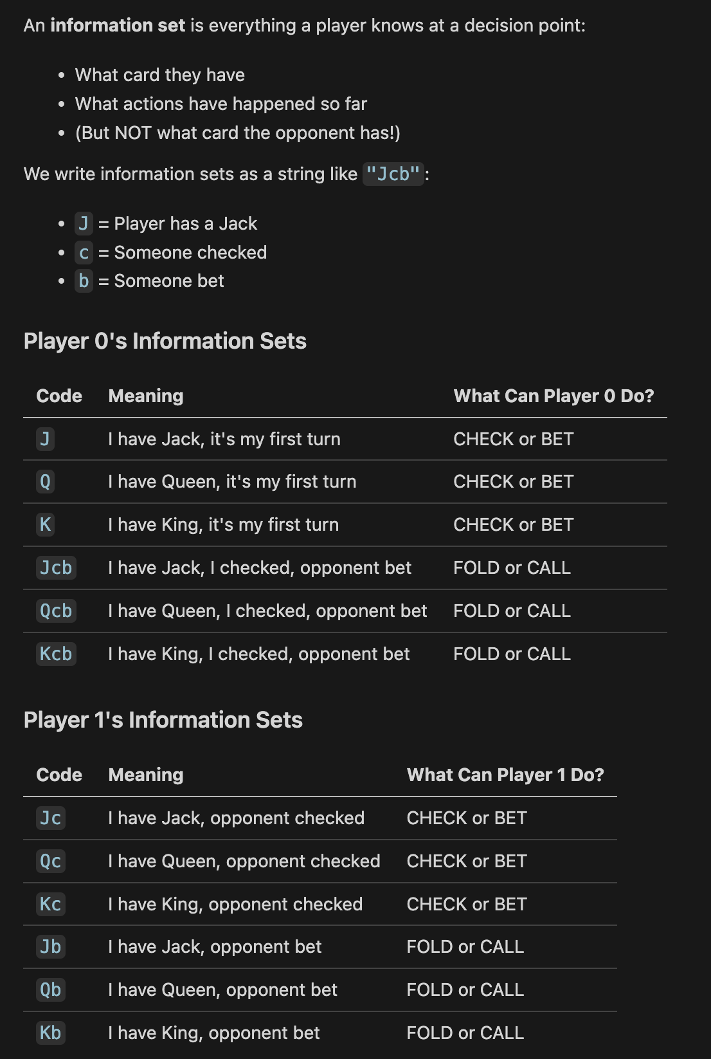
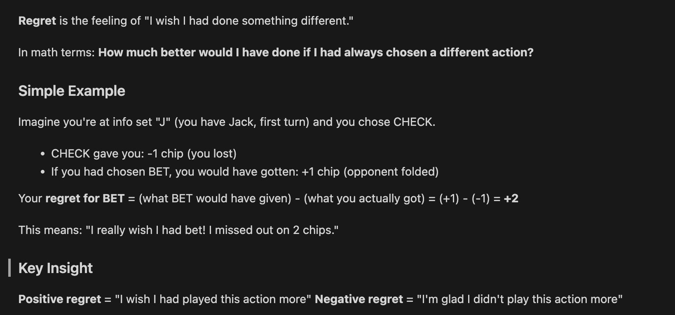
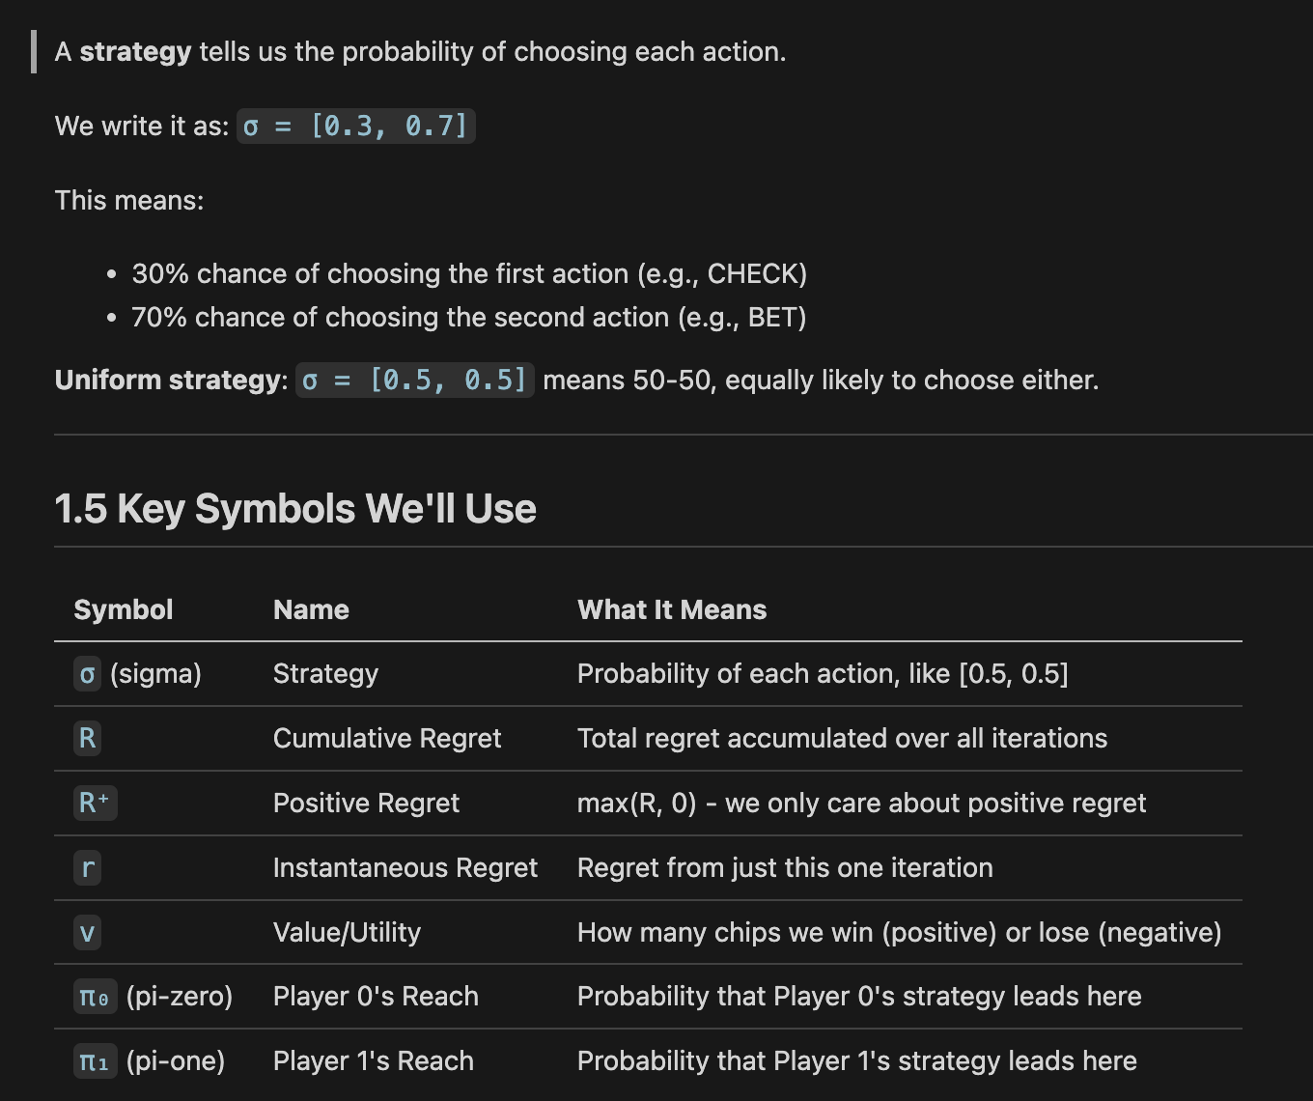

Slide 11
Algorithm 1 – CFR (Counterfactual Regret Minimization)
Maintains, for each information set I:
cumulative_regret[I][a]
strategy_sum[I][a]
Per iteration:
Traverse game tree recursively with reach probabilities for each player.
At terminal nodes: return utility.
At decision nodes for player p:
Compute current strategy via regret matching from cumulative_regret.
Recursively compute utility for each action.
Compute expected utility under current strategy.
Update counterfactual regrets based on (utility[a] - expected_utility) weighted by opponent reach.
Update strategy_sum with current strategy and reach.
After many iterations: Average strategy = strategy_sum / sum(strategy_sum) → converges to Nash equilibrium.

Slide 12
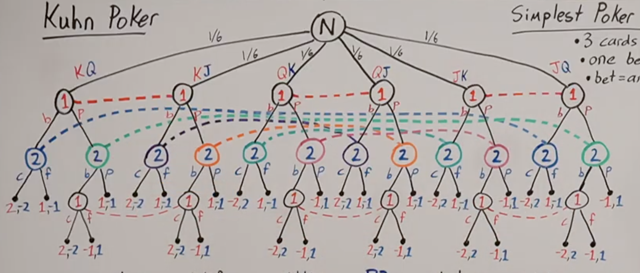

Slide 13
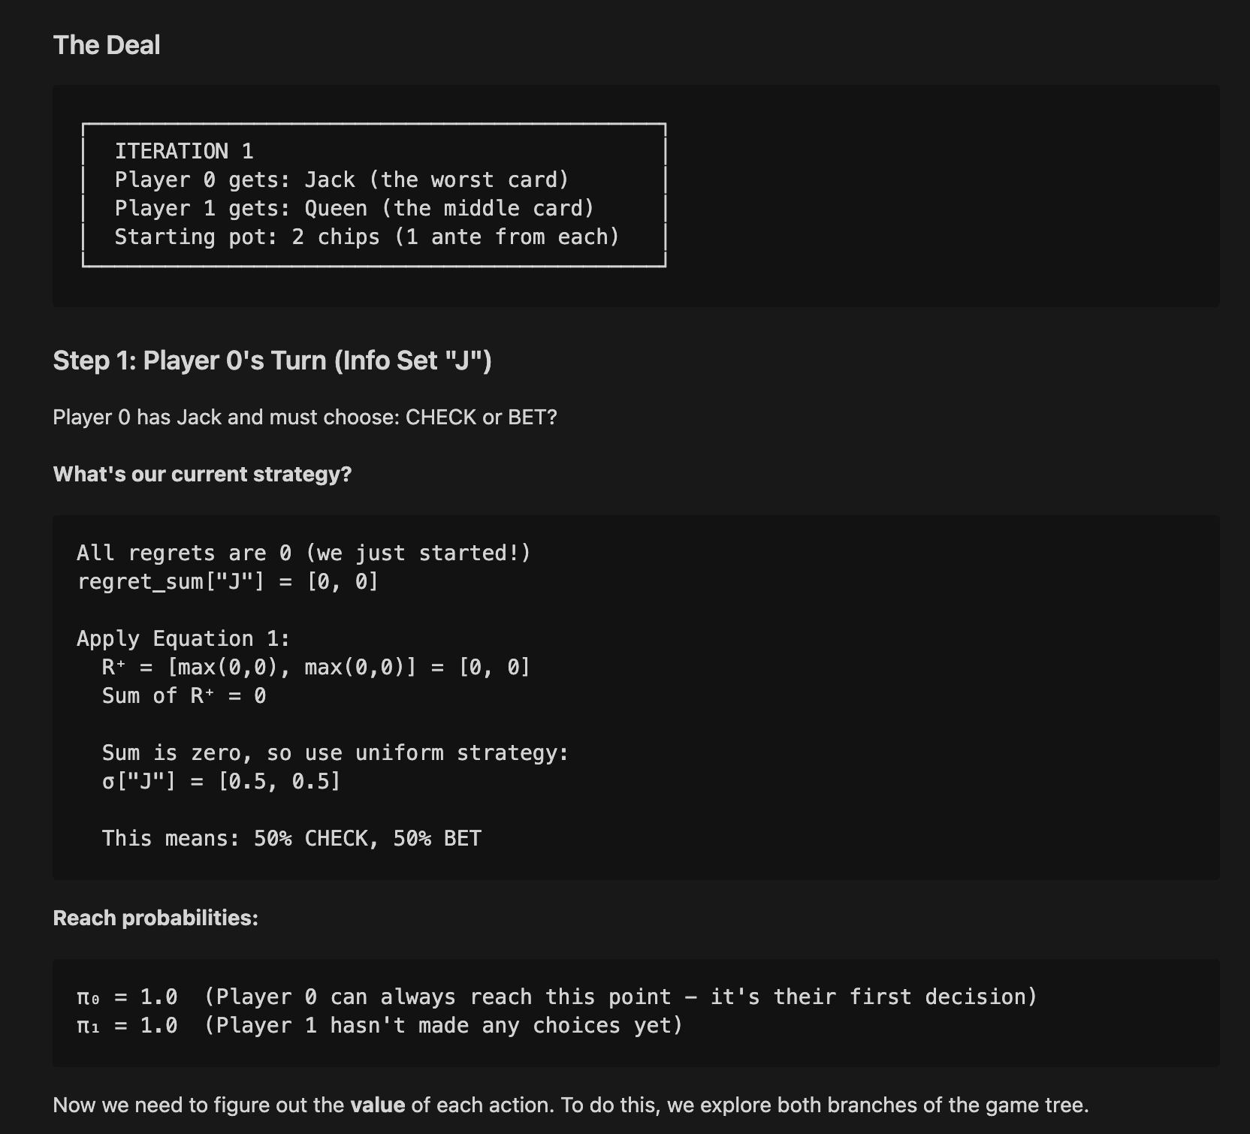
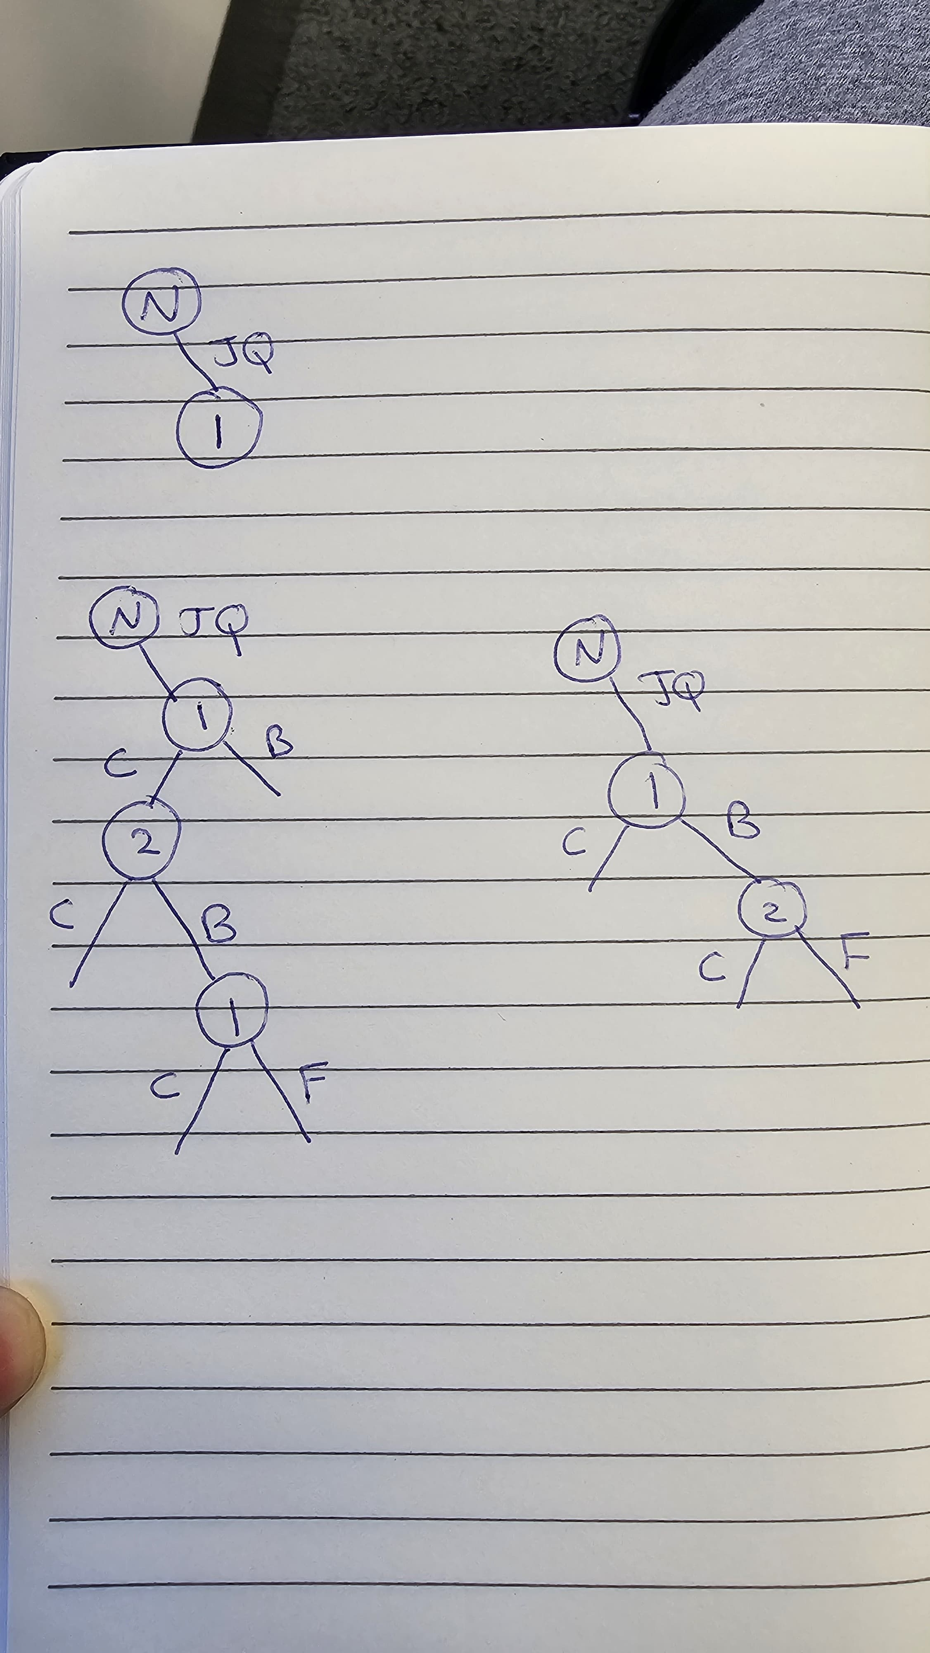

Slide 14
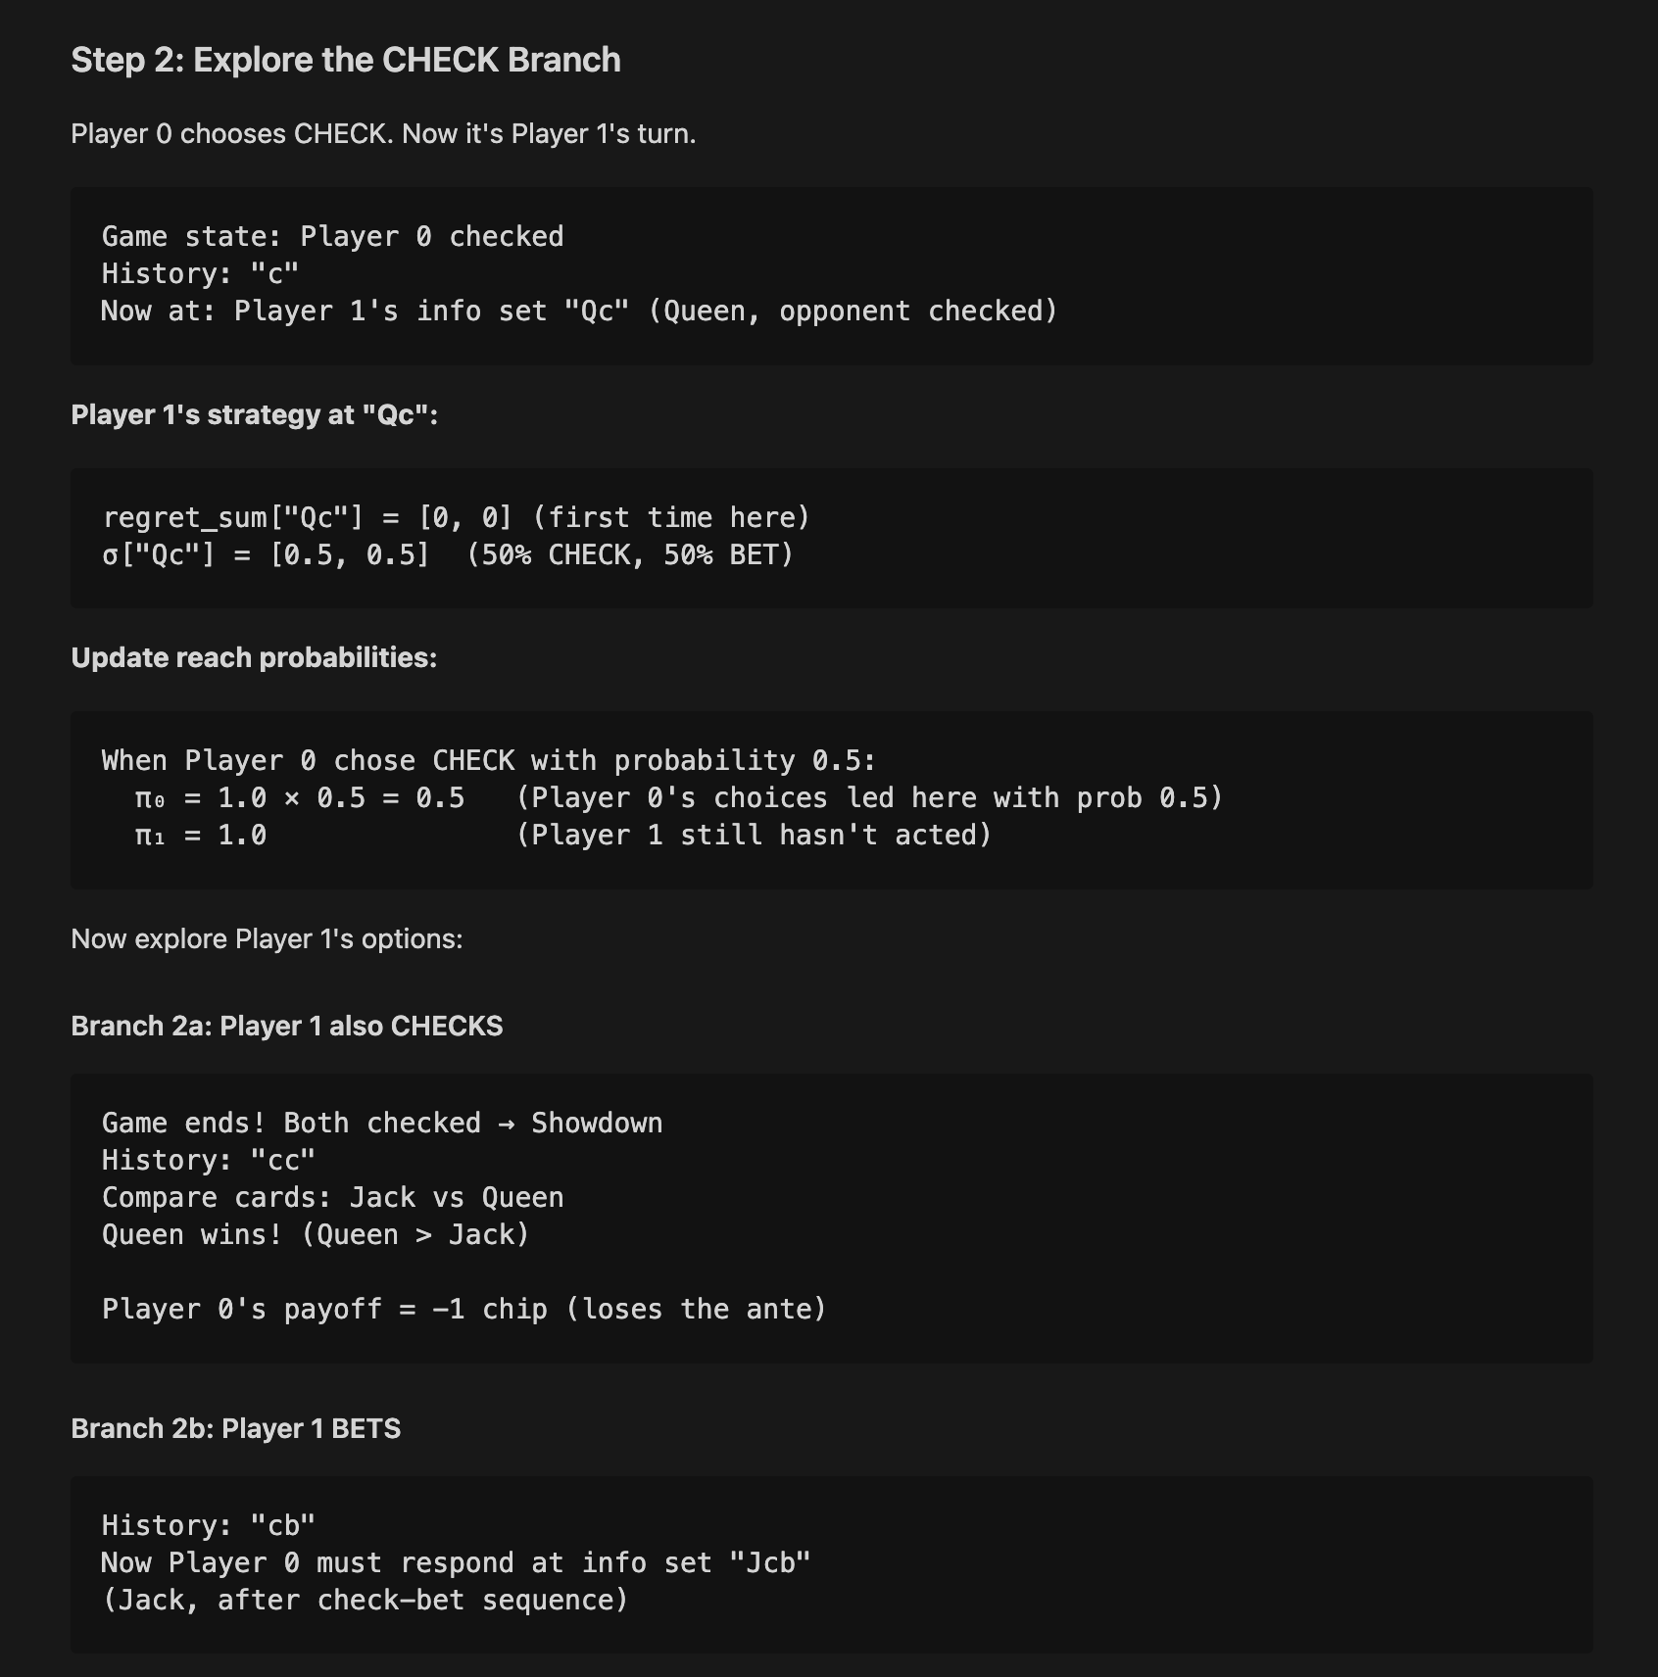
-1

Slide 15
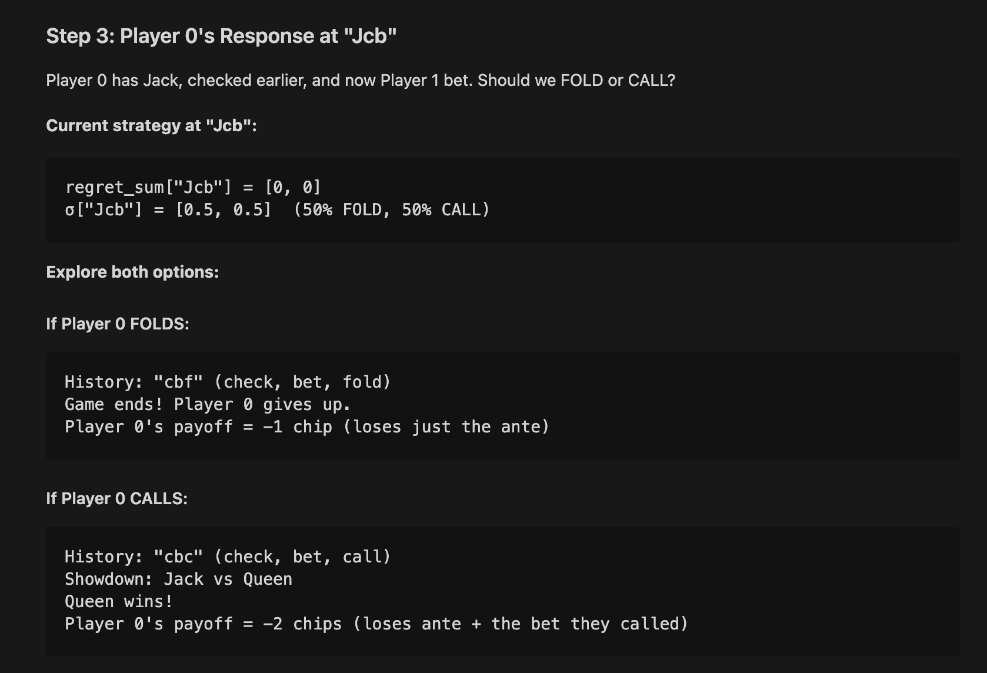
-1
-2
-1

Slide 16
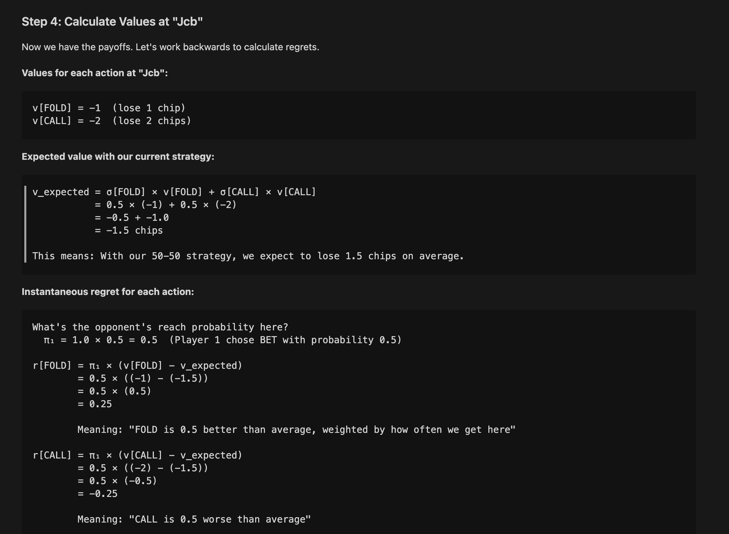
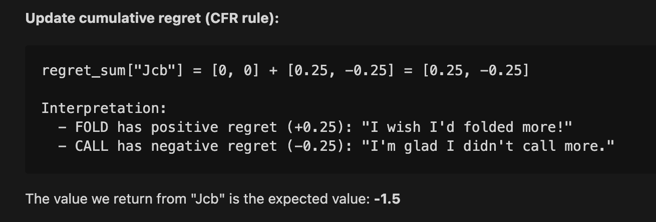
-1
-2
-1

Slide 17
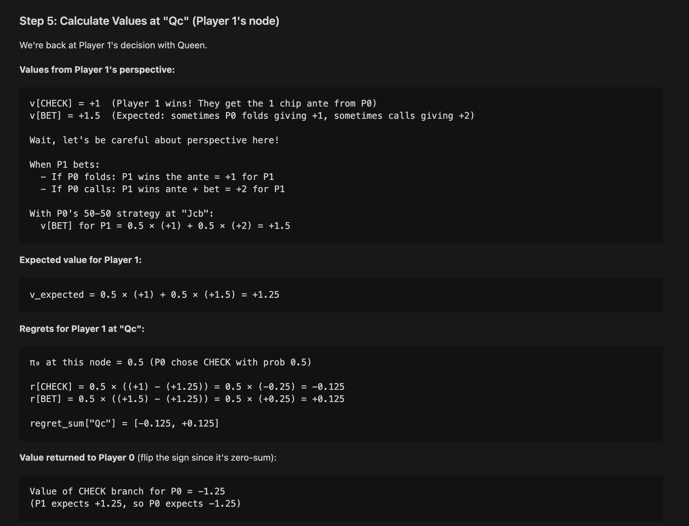

Slide 18
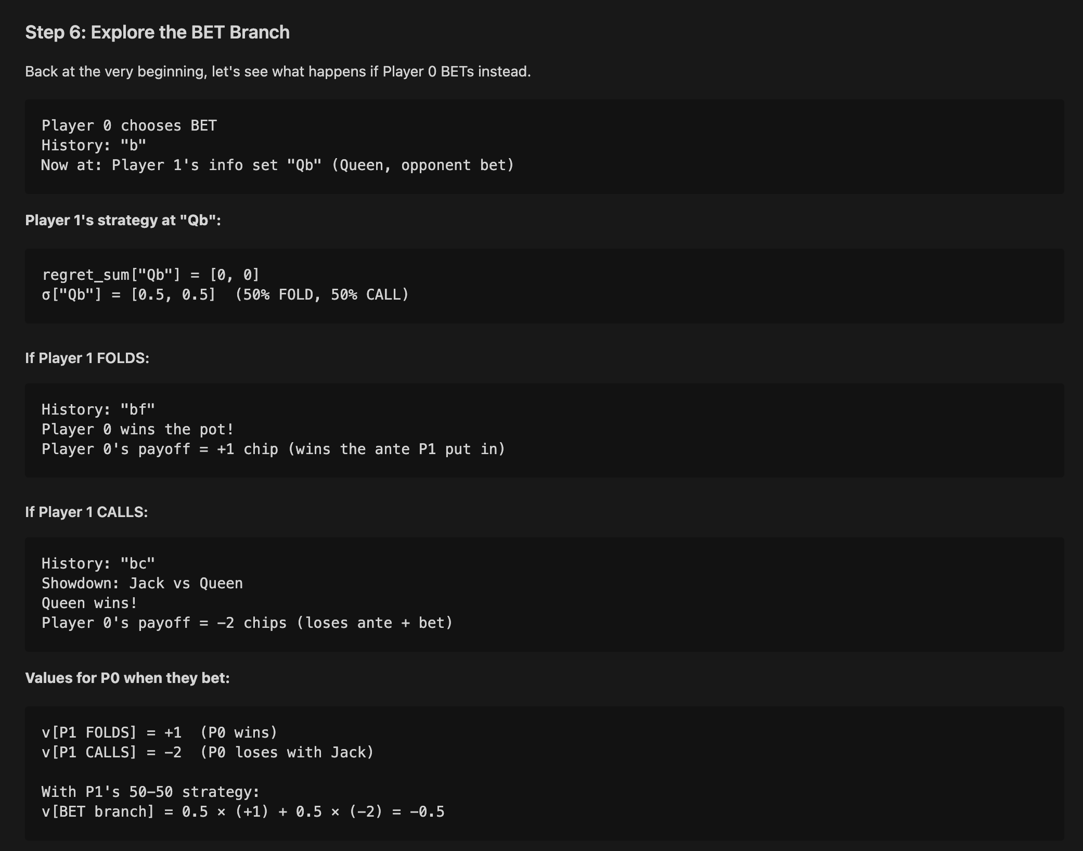

Slide 19
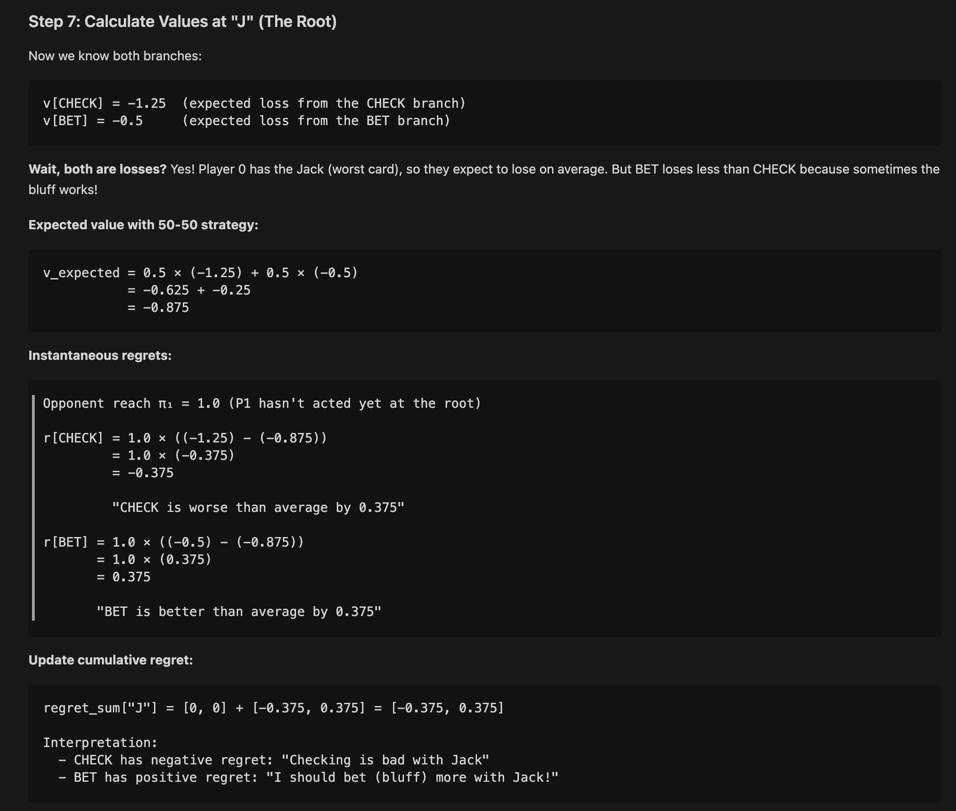
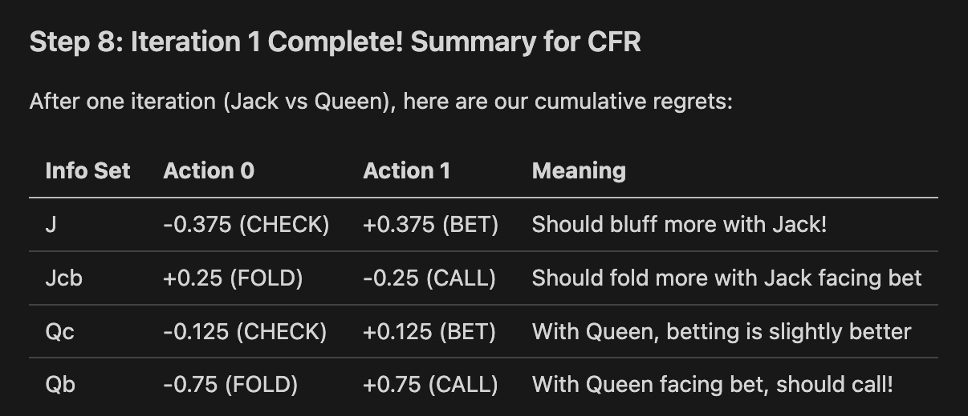
-1.25
-0.5

Slide 20
Algorithm 2 – CFR+ (CFR Plus)
CFR+ keeps overall CFR structure but modifies regret updates:
regret_sum[a] = max(regret_sum[a] + δ, 0).
Negative regrets are truncated to 0 (RM+).
In CFR, an action with long-term negative regret carries a “debt.”
If it later becomes good, it needs many iterations to overcome this negative sum.
In CFR+, that debt is erased → the action can recover immediately.
Additional CFR+ features mentioned:
Alternating player updates (update one player per iteration).
Weighted averaging with delay (e.g., start averaging after some iterations).
Empirically, CFR+ often converges much faster than CFR in poker games.

Slide 21
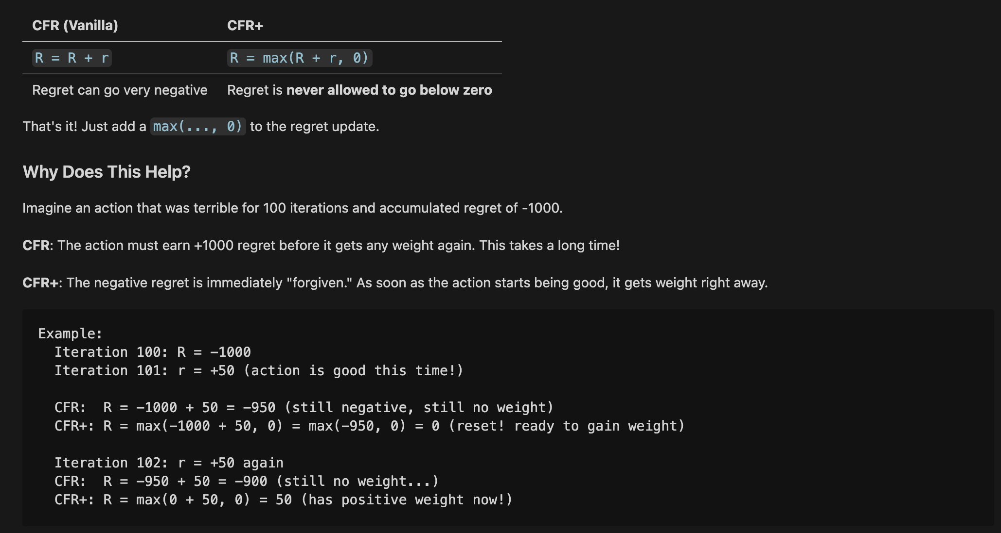
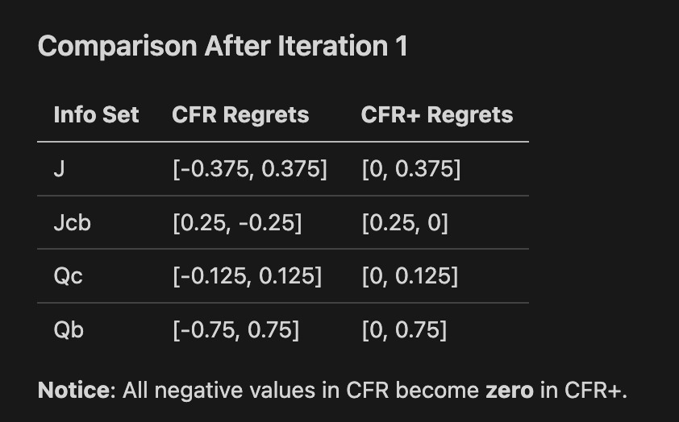

Slide 22
Algorithm 3 – NormalHedge
NormalHedge uses a potential function over regrets.
High-level steps (adapted to game-tree decisions):
Maintain cumulative regret per action.
Convert regrets to weights via an exponential / potential-based formula.
Normalize weights → probability distribution over actions.
As in CFR, do a recursive game-tree traversal and update regrets/weights.
Key properties:
Parameter-free: no learning rate to tune.
Can adapt quickly to changes in which actions are good.
For this project, NormalHedge serves as a different weighting scheme to compare with CFR/CFR+.

Slide 23
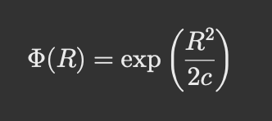
Algorithm 3 – NormalHedge
The NormalHedge potential comes from trying to design a parameter-free algorithm whose regret guarantee matches Hedge/Exp3, but without needing a learning rate.
To do that, the authors looked for a potential function that:
Grows slowly for small regret (so small fluctuations don’t dominate)
Explodes rapidly for large regret (so large missed gains trigger fast adaptation)
Supports a closed-form weight update
Gives a tight regret bound without tuning parameters
The Gaussian (normal distribution) tail turned out to be the only clean shape satisfying all these properties
This is basically the moment-generating function of a half-normal distribution.

Slide 24
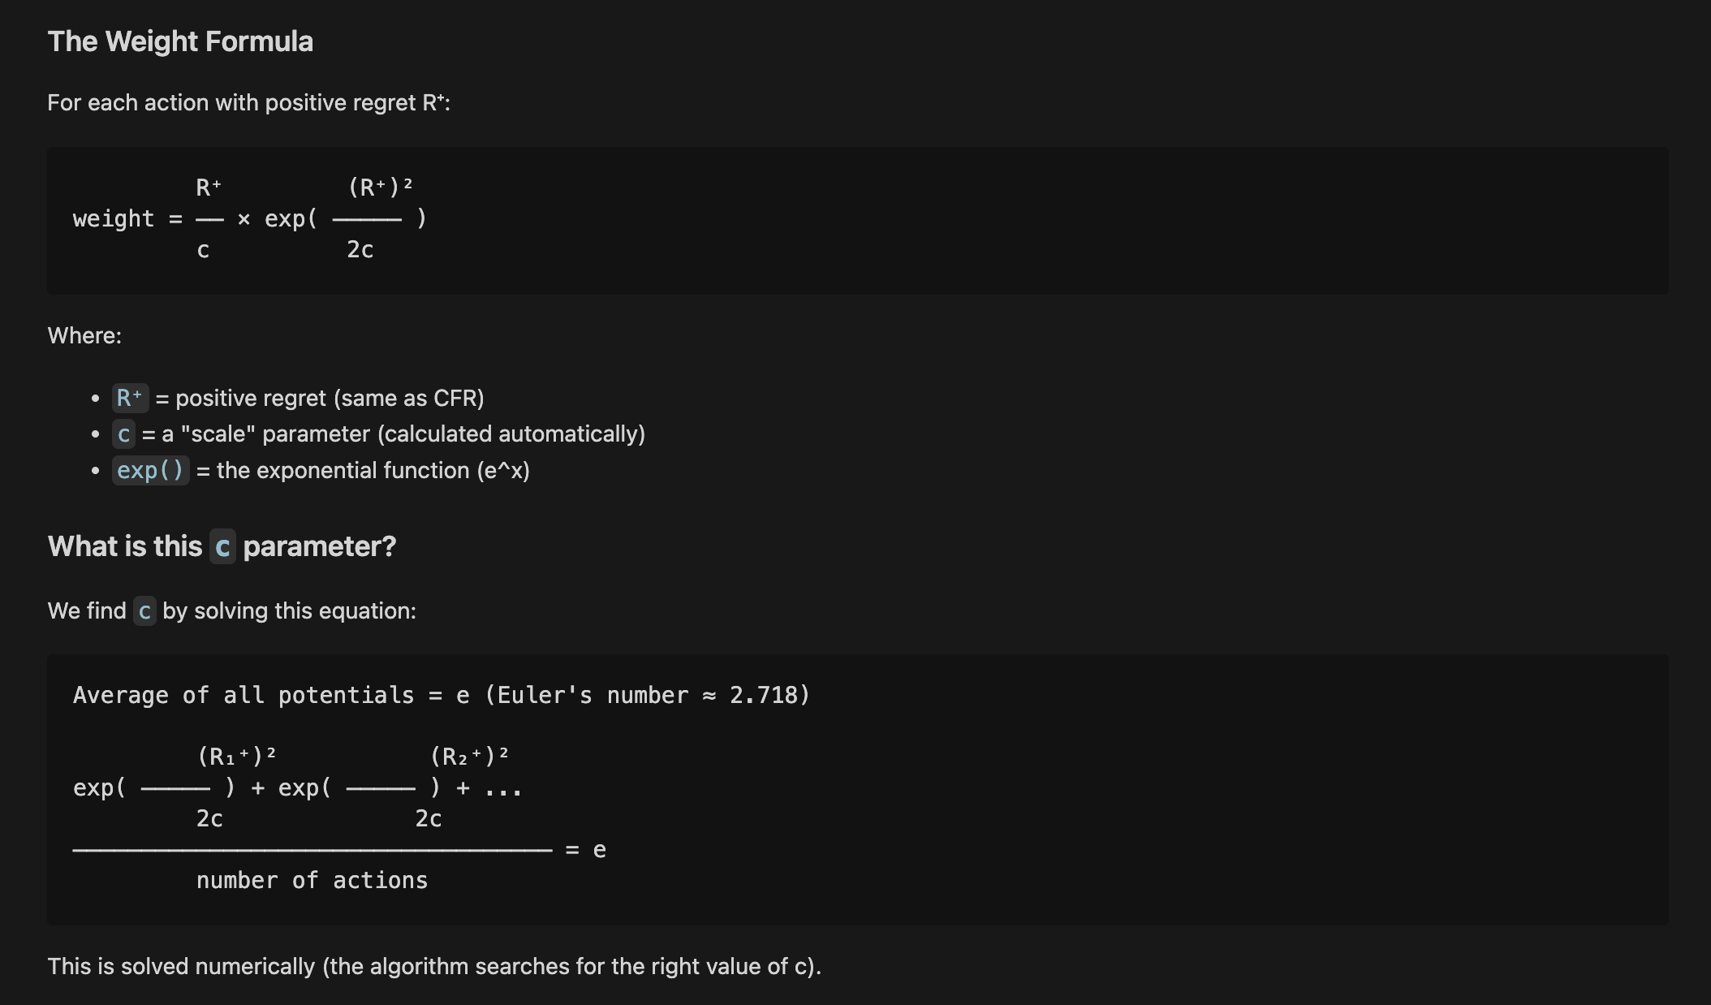

Slide 25
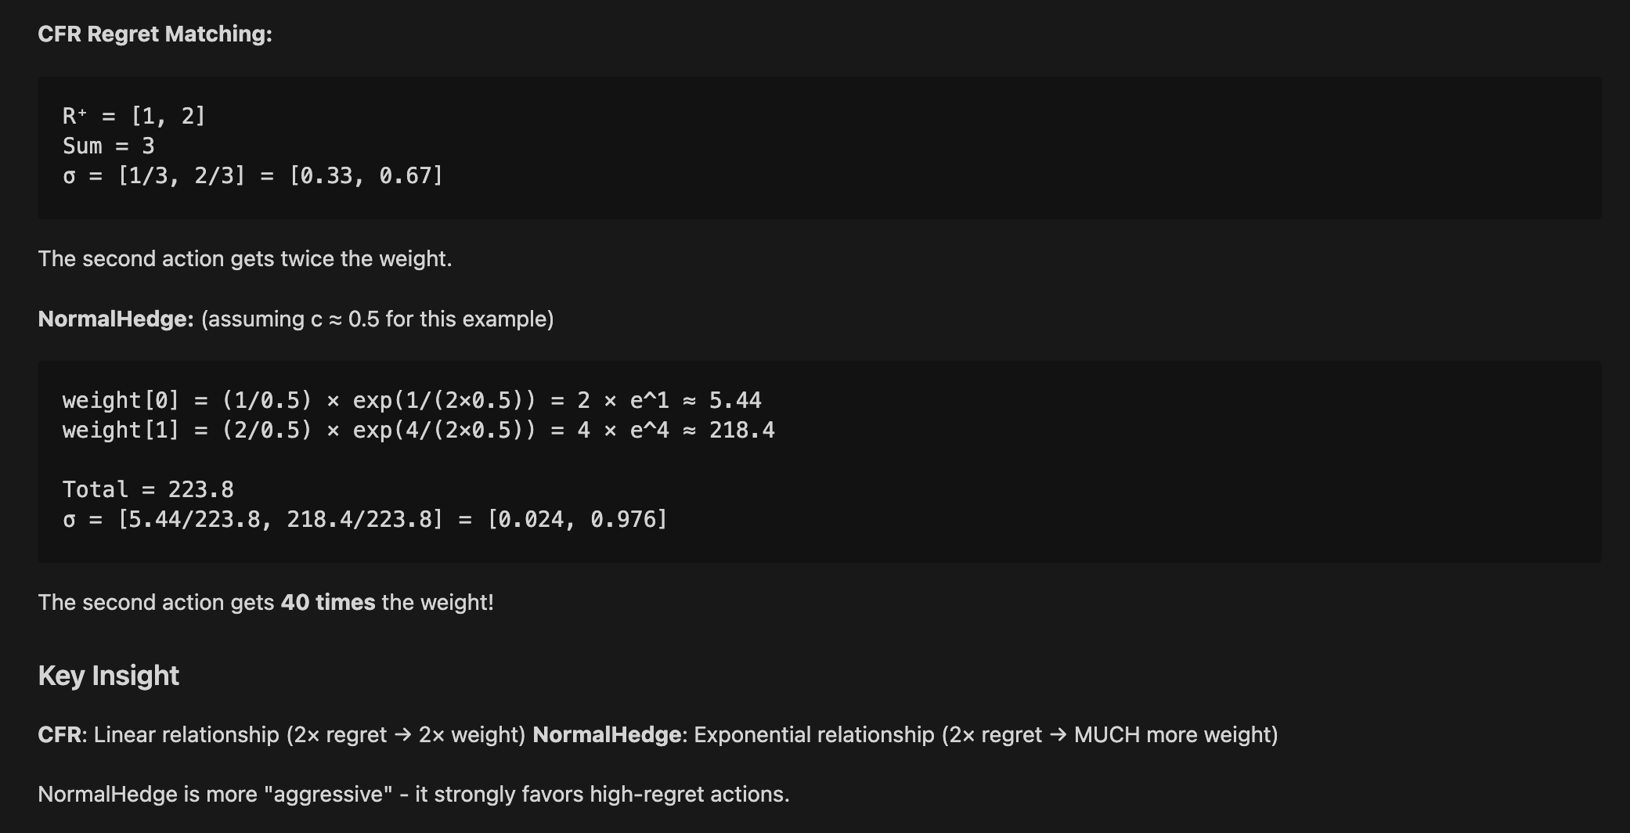

Slide 26
Algorithm 4 – NormalHedge+ (Hybrid)
NormalHedge+ combines:
NormalHedge weighting (exponential / potential-based).
RM+ truncation: regret_sum[a] = max(regret_sum[a] + δ, 0).
Motivation:
CFR+ shows that truncation accelerates CFR.
NormalHedge gives strong asymptotic guarantees and adaptivity.
Hypothesis: combining them might yield fast and robust convergence without tuning.
Implementation details:
Same game-tree recursion structure as CFR/NormalHedge.
Regret updates use truncation at 0, but strategy selection uses the NormalHedge potential instead of linear regret matching.

Slide 27
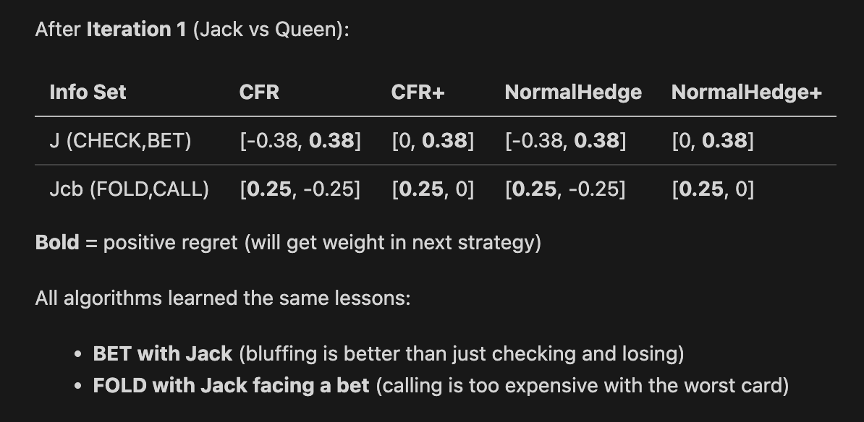

Slide 28
Experimental Setup
Game: Kuhn Poker with multiple configurations:
Standard: ante = 1, bet = 1, Nash value = -0.0556.
Large Bet: ante = 1, bet = 2.
Large Ante: ante = 2, bet = 1, Nash value = -0.1111.
Scaled Up: ante = 2, bet = 2.
Iterations:
Typical: 10,000 iterations.
Extended: 100,000 iterations (for asymptotic behavior).
Metric:
Error from Nash equilibrium for Player 0’s expected value.
We track how quickly each algorithm’s average strategy approaches the known Nash value.
Algorithms compared:
CFR, CFR+, NormalHedge, NormalHedge+

Slide 29
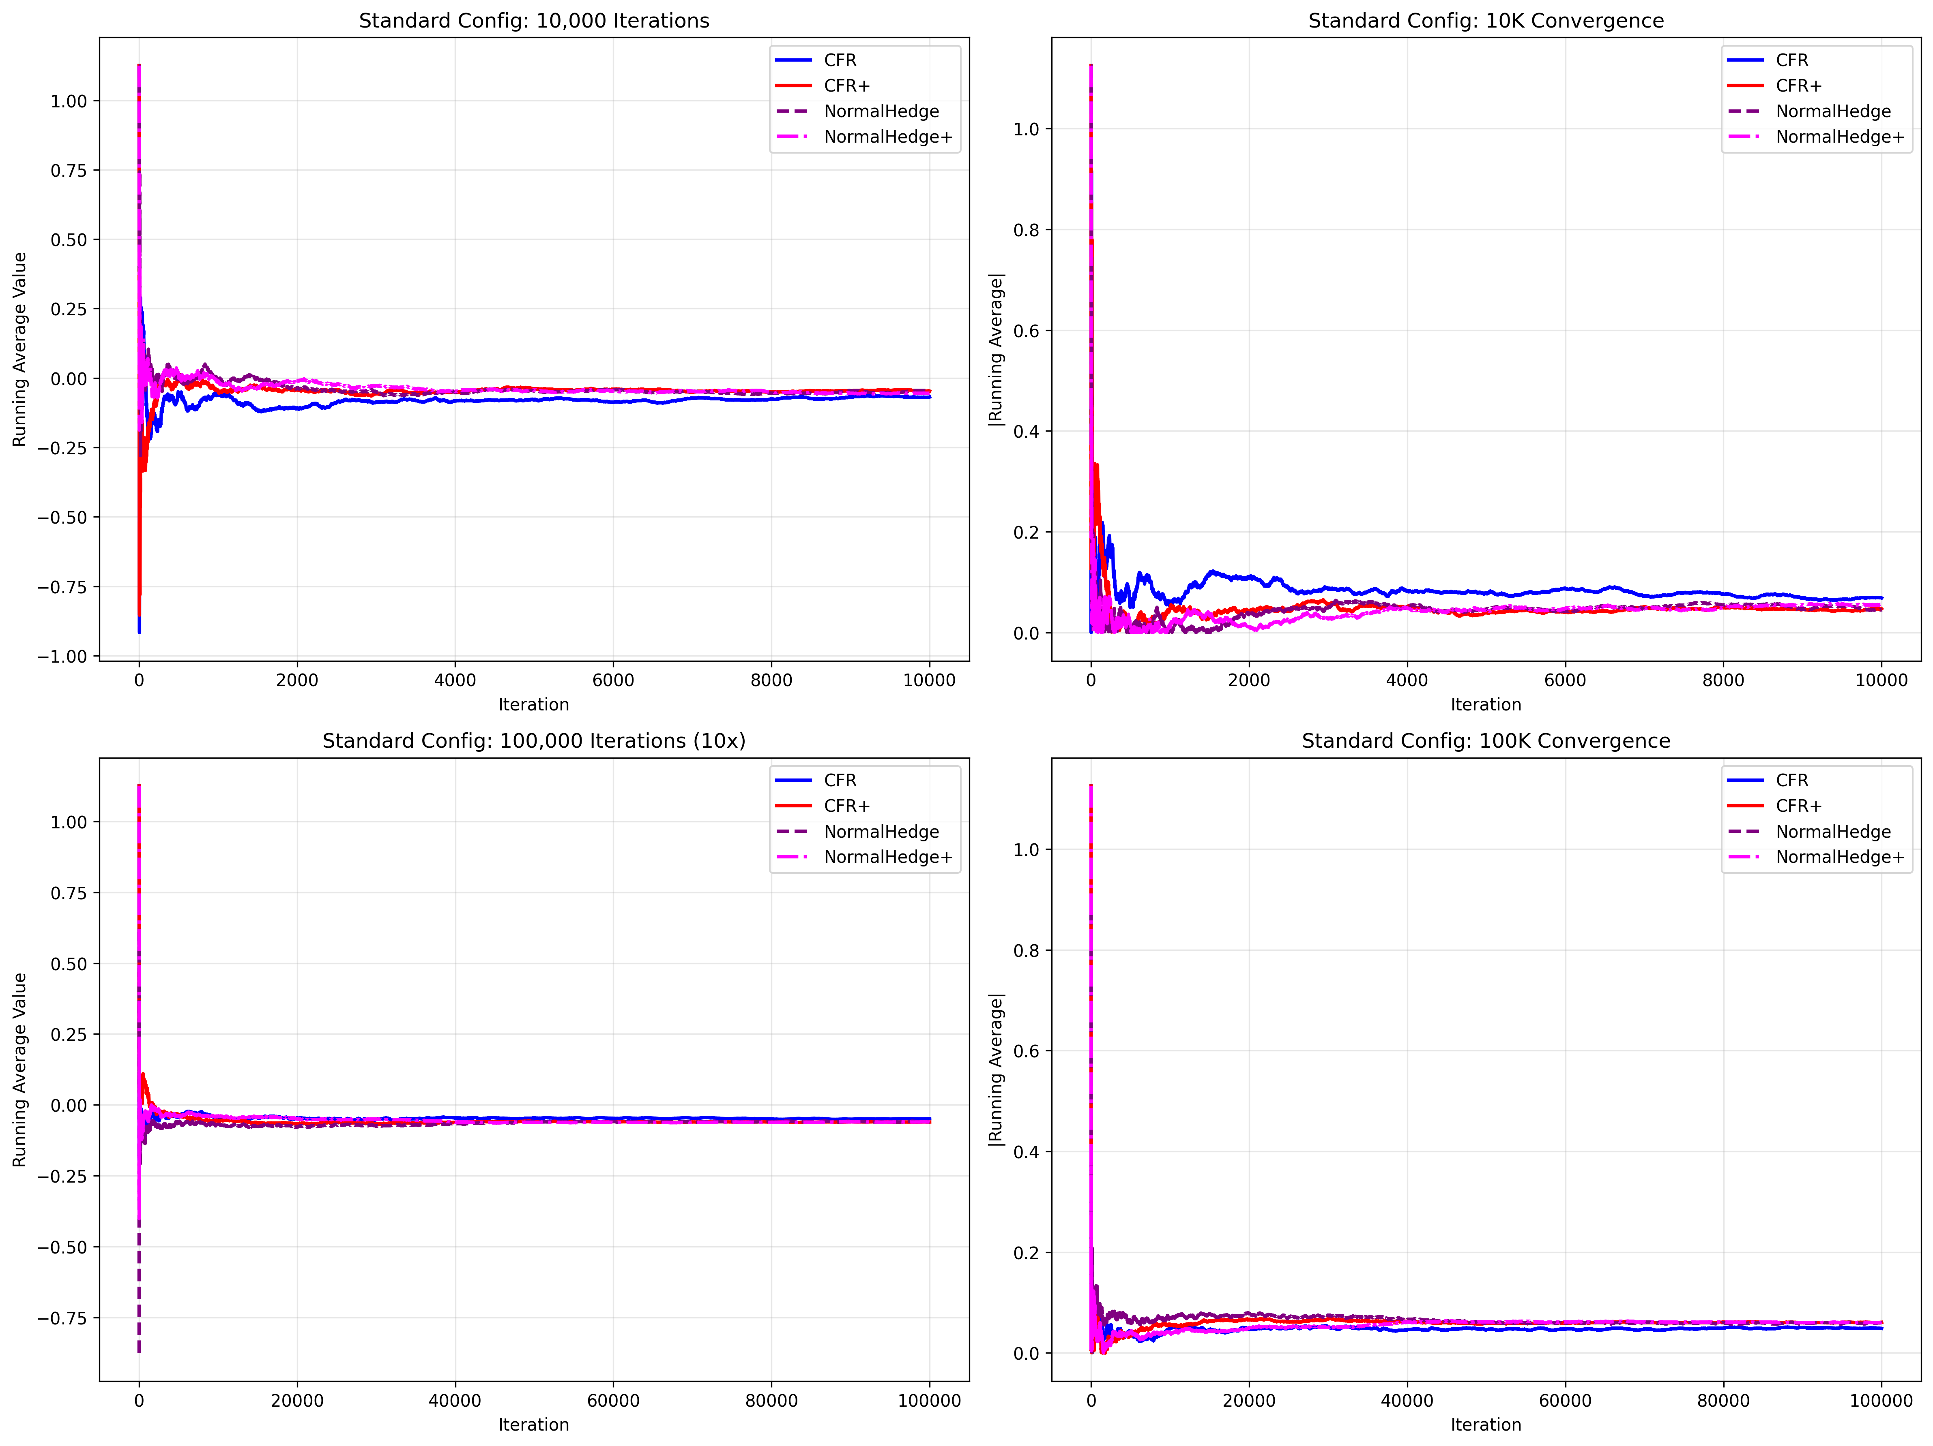

Slide 30
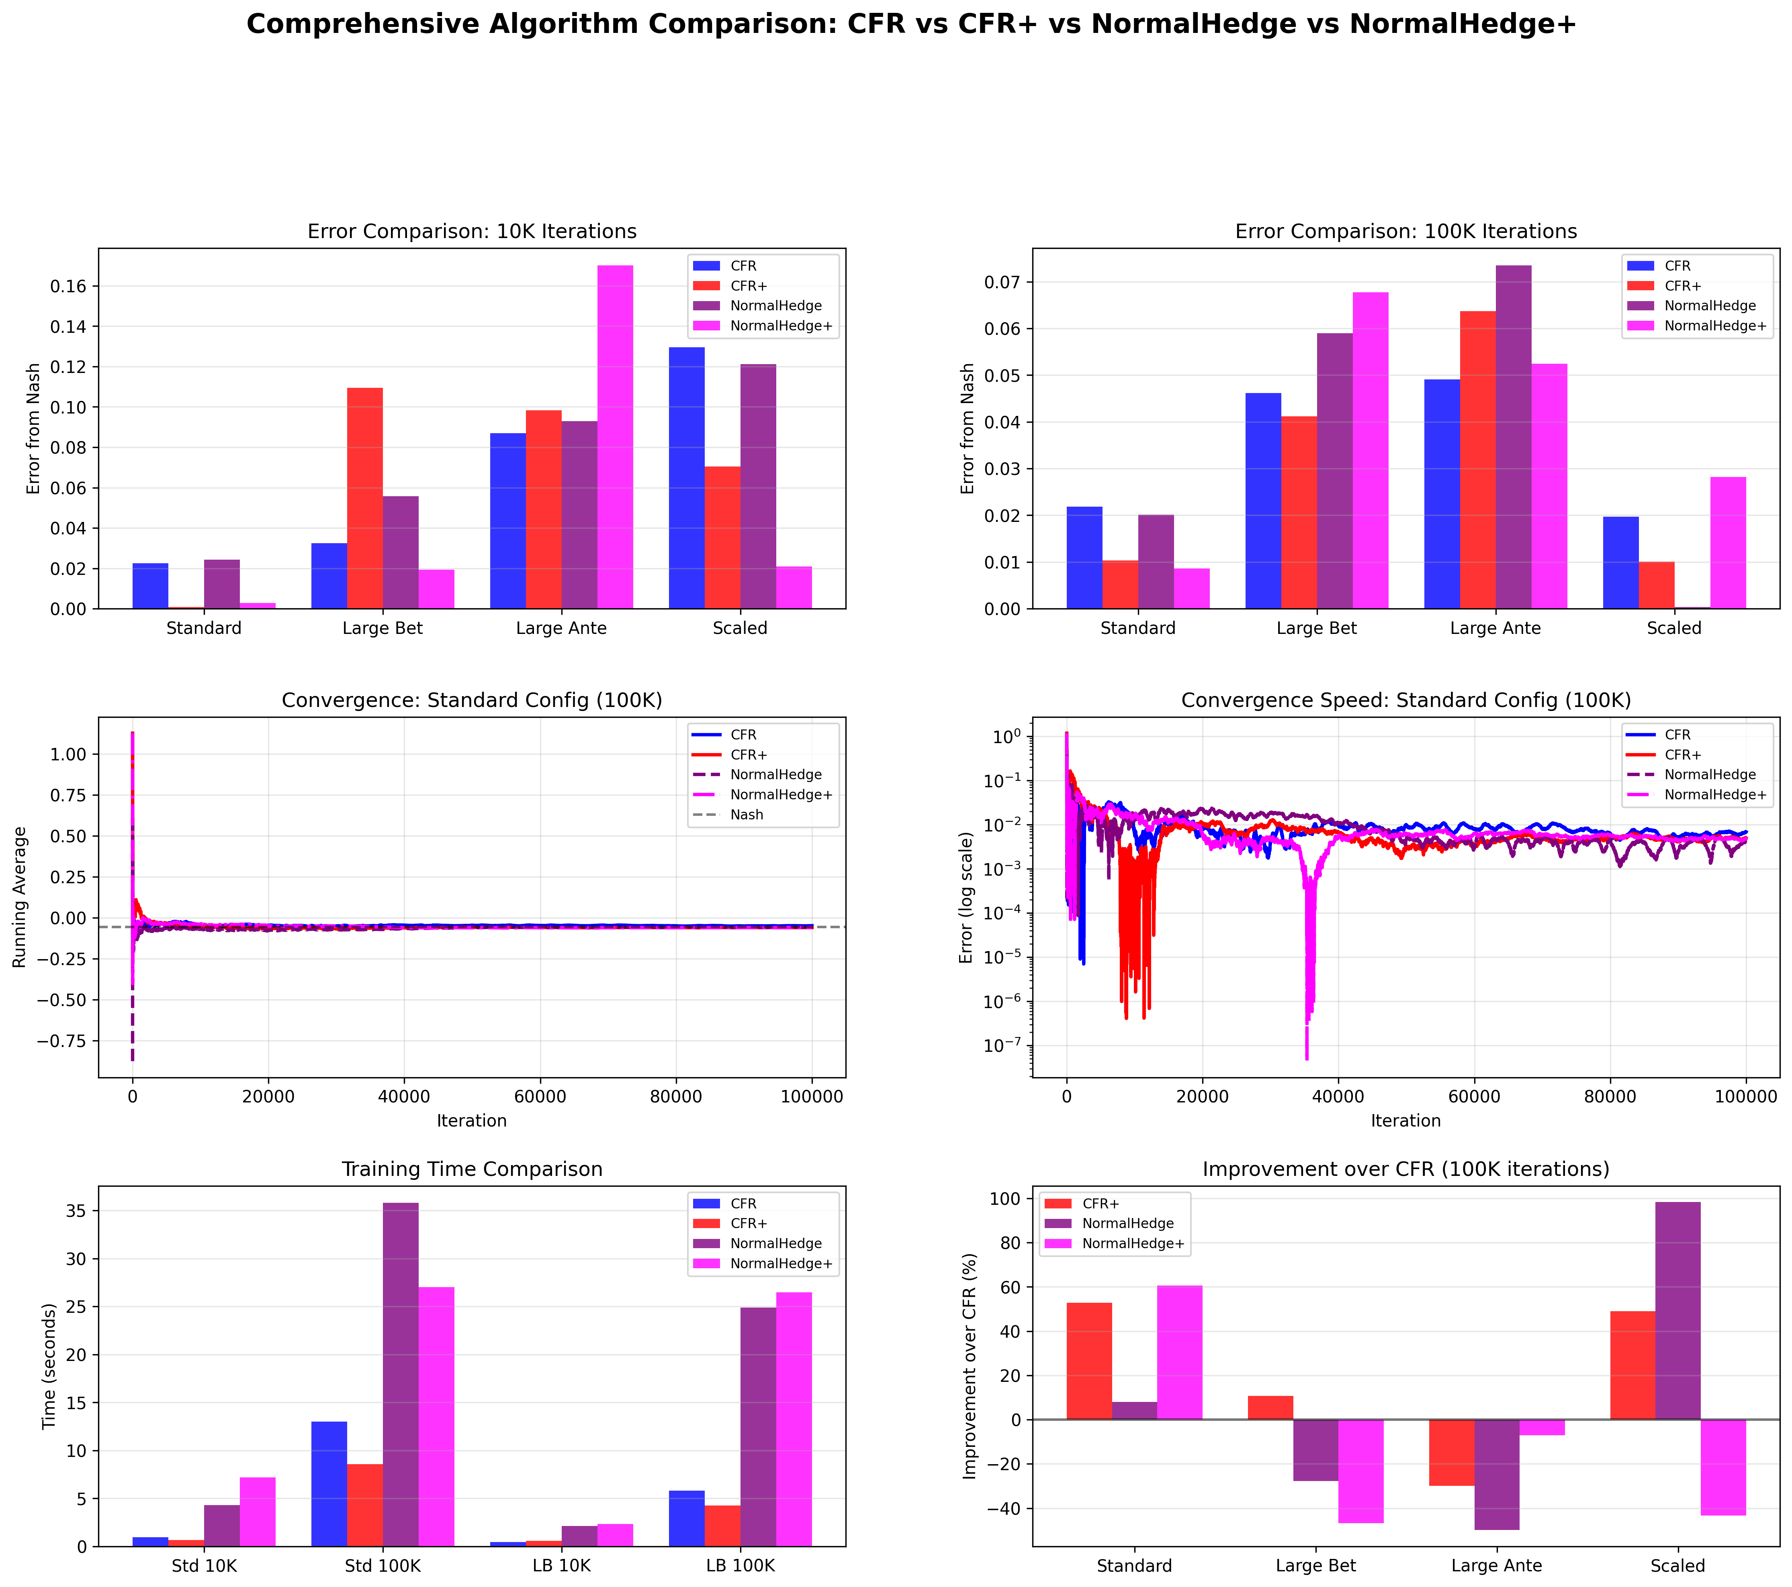

Slide 31
Results & Observations
CFR vs CFR+:
CFR+ consistently reaches low error faster than CFR across all configurations.
RM+ truncation helps especially in early to mid iterations.
NormalHedge:
Shows strong long-run performance when given enough iterations.
Sometimes slower than CFR+ in the very early phase, but competitive in the 100k-iteration regime.
NormalHedge+:
Mixed behavior:
In some configurations, truncation improves early convergence.
In others, combination of exponential weighting + truncation leads to instability or slower convergence.
RM+ truncation is powerful but interacts nontrivially with different weighting schemes.

Slide 32
Conclusions & Future Directions
RM+ truncation (used in CFR+ and NormalHedge+) can dramatically speed up convergence in regret minimization algorithms.
The benefit of truncation varies depending on the underlying weighting scheme (linear vs. exponential).
Algorithm choice depends on constraints:
Limited computation → CFR+
High accuracy needed → NormalHedge with many iterations
NormalHedge+ is a promising but incomplete idea that requires further theoretical analysis and empirical investigation.

